Slide 1
To walk or not to walk?
By Matt Mecca

Slide 2
Question
In New York City, which pickup locations have the highest percentage of trips where walking is faster than taking a taxi?

Slide 3

Assumptions
We assumed that, on average, people walk about 3.10 MPH
That would translate to taking approximately 19.354 minutes in order to walk one mile.
I.e., $\frac{60}{3.10}=19.354$ minutes
Thus, in order to calculate estimated walk duration, we multiply 19.354 by the recorded trip distance
We also assumed people would not, even if it made sense time-wise, walk more than 1.5 miles
And so we removed from the population all observations for which the trip distance exceeded 1.5 miles before generating our random sample

Slide 4
Assumptions
We assume that there being more walkers will not slow average walking speed (and, conversely, that there being fewer walkers will not quicken average walking speed)
A rather unrealistic assumption
Controlling for it would most likely make future analysis more reliable
Also we assumed that, on average, it took about three minutes for an individual to first hail, then initialize, and finally complete the transaction necessary when taking a cab.
Because of this we chose to add three minutes to the trip duration of each individual observation

Slide 5
Initial Population Data
Variable | Obs.s | Mean | Std. Dev. | Min | Max
Trip Duration (Mins) | 1,048,575 | 18.52 | 22.78 | 3.00 | 1442.73
Walk Duration (Mins) | 1,048,575 | 64.00 | 5623.48 | 0.00 | 5496536.00
Trip Distance | 1,048,575 | 3.32 | 277.85 | 0.00 | 284000.00
Passenger Count | 1,048,575 | 1.70 | 1.31 | 0.00 | 9.00
Fare Amount | 1,048,575 | 12.72 | 10.92 | -410.00 | 900.00
Tip Amount | 1,048,575 | 1.69 | 2.49 | -3.70 | 430.00
Tolls Amount | 1,048,575 | 0.29 | 1.48 | -12.50 | 445.54
Total Cost | 1,048,575 | 15.78 | 13.31 | -410.30 | 900.30
Note: There were outliers that we felt were not representative of the general population (a 1442.73 minute taxi ride, e.g.); we assumed this data was inputted incorrectly and thus chose to remove it outright

Slide 6
Project Population Data
We used New York City’s Yellow taxi data from May of 2016
I felt that, historically, May is a mild enough month that people will, all other things equal, be indifferent towards walking
Google has the average temperatures of NYC in May as 72º/54º
This was important, as it avoided a potential sample bias
E.g., in a colder month (January, say), rather than walk, would-be pedestrians might be more inclined to take a cab, which presumably would make the roads more congested than they otherwise would have been in a fairer weather month
The idea was that this congestion might increase trip duration in some months more than others
May was thought to be neutral in this regard

Slide 7
Project Population Data
We take our project’s population data to be the original data collected by Yellow Taxi (or whomever) after applying our project’s conditions to it (and thus not the same as “initial” population data)
I.e., taking out trips that spanned more than a mile and a half and trips without recorded x and y pickup coordinates, adding three minutes to each trip’s duration, etc.

Slide 8
Project Population Data
Variable | Obs | Mean | Std. Dev. | Min | Max
Trip Duration (Mins) | 430,754 | 9.381467 | 3.490699 | 3 | 141.5667
Walk Duration (Mins) | 430,754 | 18.26833 | 6.691234 | 0 | 29.031
Trip Distance | 430,754 | 0.9439044 | 0.3457287 | 0 | 1.5
Passenger Count | 430,754 | 1.672426 | 1.294444 | 0 | 9
Fare Amount | 430,754 | 6.431574 | 4.846121 | -250 | 900
Tip Amount | 430,754 | 0.8824806 | 1.454192 | -1.06 | 430
Tolls Amount | 430,754 | 0.0091699 | 0.304597 | -5.54 | 70
Total Cost | 430,754 | 8.395148 | 5.508883 | -250.3 | 900.3
Time Difference | 430,754 | -8.88686 | 5.53593 | -25.99767 | 138.9833
Walk Indicator (∝) | 430,754 | 0.0493809 | 0.2166622 | 0 | 1
Note the smaller standard deviations after both paring down and removing the outliers

Slide 9
Project Population Data
I generated a “Time Difference” variable here
Time_Difference ≡ Trip_Duration – Walk_Duration
As we can see, there are far more trips that took less time than walking would have
It seems that only the right tail of our distribution is positive
Interesting tidbit: after adjusting our initial population dataset to be in line with our project’s assumptions, we find that the Time Difference variable’s distribution is almost perfectly normal (or, perhaps because our random variable is discrete, we might say perfectly Poisson with mean |𝝀| = |𝝁| and variance |𝝀 |= |𝝈²|)
This is in line with the basic premise of the ^{Central} Limit Theorem, and something that I found to be pretty cool

Slide 10
Project Population Data
As you can see to the left, not controlling for time of day, pickup location, etc., walking is quicker than taking a cab roughly 4.85% of the time
Note: Pie charts aren’t great representations of data normally, but I figured that, before really going into detail (controlling for region, time, etc.), it would give us a good idea of what our baseline is

Slide 11
Sample Data
To be able to work with the data –– which spanned over a million observations –– we had to take a random subset of the project population. Our resulting sample dataset consisted of 8% of the project population, or approximately 34,460 observations.
Variable | Obs | Mean | Std. Dev. | Min | Max
Trip Duration (Mins) | 34,460 | 9.38 | 3.58 | 3.00 | 141.57
Walk Duration (Mins) | 34,460 | 18.28 | 6.69 | 0.00 | 29.03
Trip Distance | 34,460 | 0.94 | 0.35 | 0.00 | 1.50
Passenger Count | 34,460 | 1.68 | 1.30 | 0.00 | 9.00
Fare Amount | 34,460 | 6.41 | 4.11 | -5.00 | 290.00
Tip Amount | 34,460 | 0.90 | 2.74 | 0.00 | 430.00
Tolls Amount | 34,460 | 0.01 | 0.29 | 0.00 | 17.54
Total Cost | 34,460 | 8.39 | 5.27 | -6.30 | 433.30
Time Difference | 34,460 | -8.90 | 5.64 | -25.06 | 138.03
Walk Indicator (∝) | 34,460 | 0.05 | 0.22 | 0.00 | 1.00

Slide 12
Sample Data
Note that, save the number of observations, our Time Difference variable’s distribution and the percentage of time we ought to walk is roughly the same
This serves as verification that our random subsampling was indeed random (and thus a success)

Slide 13
Subset of Sample Data (for CARTO)
In order to illustrate the data (in CARTO), we had to pare down our sample dataset even further
This meant randomly selecting a subset that was 2.5% of the sample (and thus 0.20% of the project population), or approximately 861 observations.
Variable | Obs | Mean | Std. Dev. | Min | Max
Trip Duration (Mins) | 861 | 9.299477 | 3.368524 | 3.05 | 30.01667
Walk Duration (Mins) | 861 | 18.47576 | 6.77552 | 0 | 29.031
Trip Distance | 861 | 0.9546225 | 0.3500837 | 0 | 1.5
Passenger Count | 861 | 1.67712 | 1.30662 | 1 | 6
Fare Amount | 861 | 6.471312 | 4.343102 | 0 | 90
Tip Amount | 861 | 0.892741 | 1.437047 | 0 | 25.25
Tolls Amount | 861 | 0.0348897 | 0.7336224 | 0 | 17.54
Total Cost | 861 | 8.470023 | 5.437939 | 0 | 121.05
Time Difference | 861 | -9.176287 | 5.630713 | -21.84767 | 19.06667
Walk Indicator (∝) | 861 | 0.0545877 | 0.2273057 | 0 | 1
12:00 to 4:00 AM | 861 | 0.116144 | 0.3205838 | 0 | 1
4:00 to 8:00 AM | 861 | 0.068525 | 0.2527915 | 0 | 1
8:00 AM to 12:00 PM | 861 | 0.1521487 | 0.3593737 | 0 | 1
12:00 to 4:00 PM | 861 | 0.1788618 | 0.3834593 | 0 | 1
4:00 to 8:00 PM | 861 | 0.2601626 | 0.4389782 | 0 | 1
8:00 PM to 12:00 AM | 861 | 0.224158 | 0.417269 | 0 | 1

Slide 14
Subset of Sample Data (for CARTO)
Note that, again, save the number of observations, our Time Difference variable’s distribution and the percentage of time we ought to walk is roughly the same as our other two datasets
This serve as further verification that our random subsampling was again a success

Slide 15
Methodology
Idea was that whenever our walk duration was less than our (adjusted) trip duration, walking was thought to be quicker than taking a cab
Later on I might mention that our “walk indicator” was set off X times (or sometimes X percentage of the time). This simply means that our Walk Indicator dummy (i.e., when walking was quicker than taking a cab) had a value of one X times (in that regard it’s referred to as a sum, though other times it will be referred to as a proportion)
We look to see how much our “walk indicator” varies with both the region and time in which someone starts their trip/walk

Slide 16
Methodology
Explore which areas warrant the most walking using a visual guide
For this I first used ArcMap to create a zip file that mapped the trips from a to b, and then I used CARTO to make an interactive interface
Again, the data that we used in CARTO was a subset of our sample data
Conduct a statistical analysis of those areas using R
Use dummies to classify both region and time
Answer the question “which pickup locations have the highest percent of trips where walking is faster than taking a cab”?

Slide 17
Time Zones
Time of day was classified as follows:
12:00 to 4:00 AM, “Wee Hours”;
4:00 to 8:00 AM, “Early Morning”;
8:00 AM to 12:00 PM, “Morning”;
12:00 to 4:00 PM, “Early Afternoon”;
4:00 to 8:00 PM, “Rush Hour”; and
8:00 PM to 12:00 AM, “Evening”

Slide 18
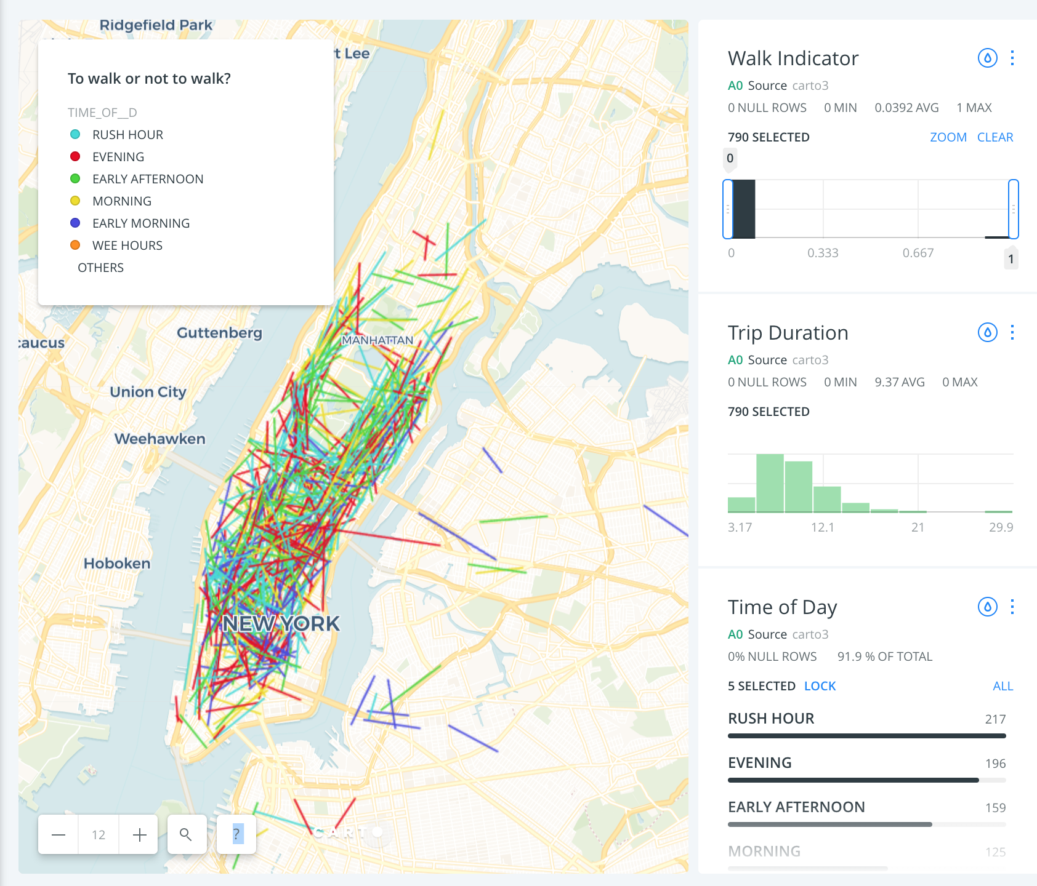
Exploring our Map
One thing that we get from this CARTO map (other than a headache) is that Yellow Taxi operates primarily (and almost exclusively) in Manhattan
Another thing worth mentioning is that it’s during the afternoon (or during rush hour and the evening, to be more specifical) when Yellow Taxi is busiest
Note: To play around with the map yourself, you can do so using the following link:
https://nyu.carto.com/u/mmm1017/builder/9291437a-36ea-496c-ab66-de86ff55cfe5
Further Note: CARTO failed to pick up some of the observations that I’d inputted. I suspect it has something to do with the way it read the ZIP file that I’d imported from ArcMap, though I can’t be sure. I’ve been working on solving the issue, but I was unable to do so before submission. Regardless, it does not seem to have much of an effect on our final results/conclusions. It was a rather small error.

Slide 19
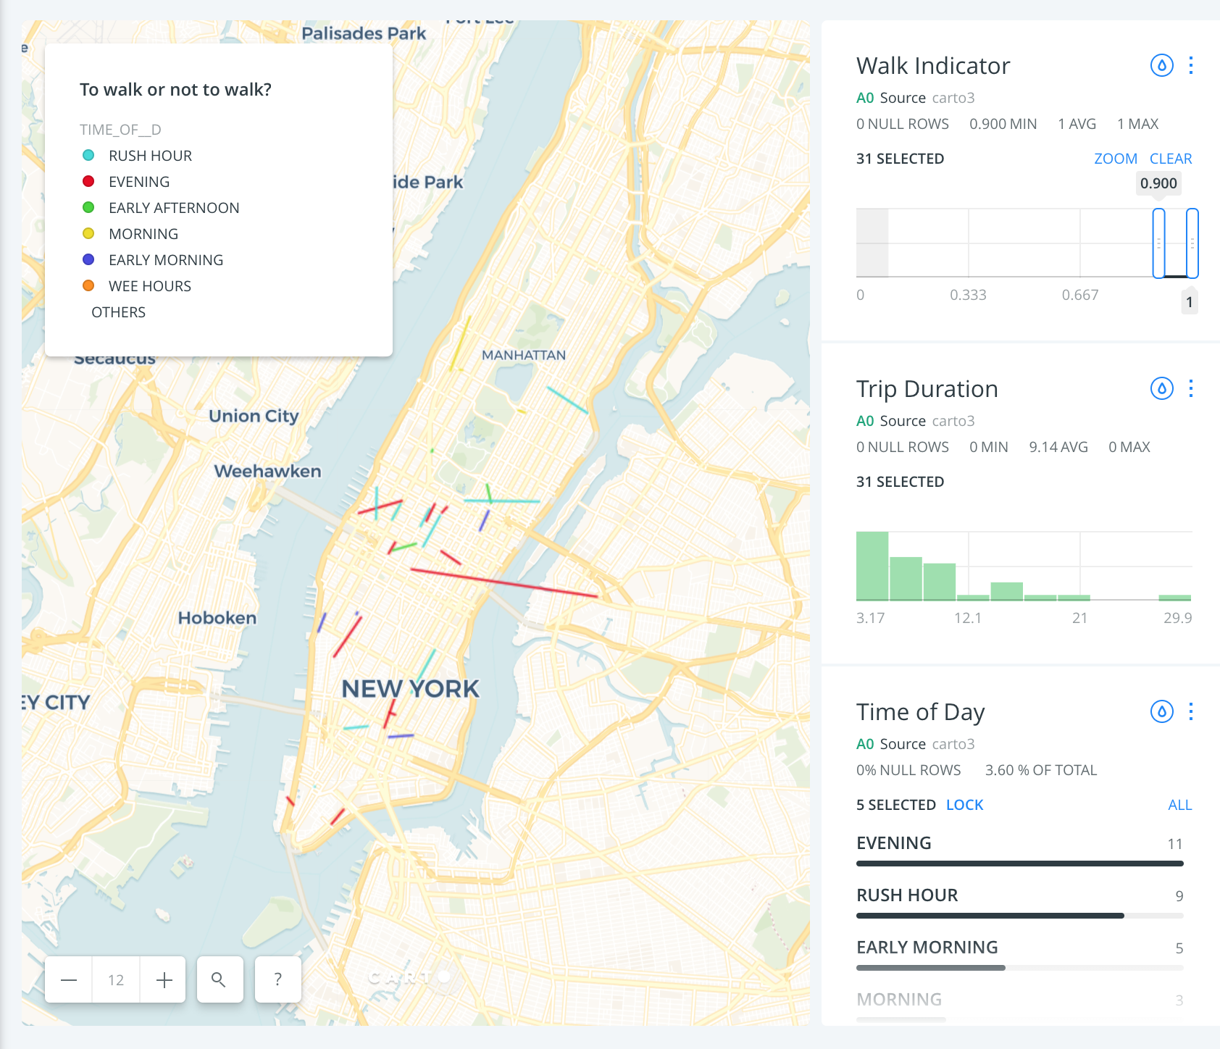
Exploring our Map –– when to walk?
Using this (perhaps too) limited dataset, we see that the walking indicator typically goes off in the Midtown/Lower Manhattan regions between 4:00 PM and 12:00 AM (or “Rush” through the “Evening” hours)
It seems (quite intuitively, I might add) that the walking indicator goes off more often almost everywhere during those hours
Another thing worth noting is that north of South Harlem there were no cases where walking was quicker than taking a cab
Before conducting a statistical analysis based on region, we make notes of the above
Note: the long red line from Midtown to Long Island City is an input error

Slide 20
Exploring Time Differences by Time of Day
Before considering our sample data on a region-by-region basis, we can first use it to further examine the “Generally speaking, walking is most likely to be the quicker option between 4:00 PM and 12:00 AM” observation we had when looking at the previous slides’ maps. To do this, we first examine the time difference histograms for the different morning and Early Afternoon time periods:

Slide 21
Exploring Time Differences by Time of Day
Now we take a look at the time difference histograms for the Rush Hour and Evening time periods:
We see that differences between the two groups does seem to warrant our notice, and so we will keep that thought in mind when moving forward.

Slide 22
Regions
We chose to divide Manhattan into four sections: the Upper East Side, the Upper West Side, Midtown, and Lower Manhattan
We did not consider observations recorded north of Central Park (as there did not seem to be much cab activity there in our exploratory analysis)
Manhattan’s Regions were classified by the following intervals in which the observation’s pickup coordinates landed. They can be described as:
40.7396835 < y-coord. < 40.765891 and -73.9906902 < x-coord. < -73.9734576, Midtown;
40.7046437 < y-coord. < 40.739684 and -74.0191965 < x-coord. < -74.0112105, Lower Manhattan;
40.7557326 < y-coord. < 40.784954 and -73.9664882 < x-coord. < -73.9535211, Upper East Side; and
40.7658910 < y-coord. < 40.793772 and -74.0317422 < x-coord. < -73.9725753, Upper West Side

Slide 23
What did we find?
First off, if you find yourself leaving Lower Manhattan between the hours of 8:00 PM to 12:00 AM, there is a 14% chance that you will arrive at your destination (assuming our project assumptions are not violated) quicker than you would have had you taken a cab
Contrary to this, it is also in Lower Manhattan that you are least likely to outwalk your cabbie –– that, though, is between the hours of 12:00 and 8:00 AM
One has to wonder what Lower Manhattan’s 8:00 to 10:00 PM slot would look like
The sudden drop-off in activity after 12:00 AM is curious
Notes:
Tables of these graphs are included in the attached Excel file

Slide 24
What did we find?
Also of note: the times in which you are most likely better off walking in the Upper West and East sides is in the Wee and Early Morning hours, respectively
This might be explained by commuters leaving their uptown homes early in the morning in order to travel downtown for work (thus causing traffic congestion)
Lastly, we ought to also note that Midtown appears to be the most consistently congested region, and thus sets off our walking indicator most often
More on this in the next slide

Slide 25
What did we find?
Here we see that Midtown, on average, is where walking is most likely going to be quicker than taking a cab
Also, its standard deviation (of probabilities across time) is in rough proportion to that of the Upper East and West sides’ (i.e., about half of each ones’ respective mean)
This suggests that the likelihood of you being better off walking is consistent in these regions
Lower Manhattan has the second highest average walk probability, but also the largest standard deviation across time
This can be explained by the possibility of the Lower Manhattanite being both best off (from 8:00 PM to 12:00 AM) as well as worst off (from 12:00 AM to 8:00 AM) when opting to walk

Slide 26
What did we find?
Lastly, we ought to note the low averages of both the Upper East and Upper West Sides
Given our exploratory analysis using CARTO, this makes sense
The East and West sides seemed the least active, Lower Manhattan seemed to be the second least (or second most), and Midtown seemed to be the most
It’s good to see that this is further substantiated when testing on our larger (and thus more reliable) sample dataset

Slide 27
Conclusions
Whether walking is likely to be quicker than taking a cab largely depends on where you’re being picked up
It was in Midtown where walking was most likely to be the quickest way of getting from a to b
Lower Manhattan was a close second, with their not being all that much a difference in the averages
In Lower Manhattan, though, whether walking was the quicker option would vary wildly based on time of day

Slide 28
Conclusions
Time of day really was important when trying to answer whether walking was quicker than taking a cab
Walking is most likely to be the quicker option during the afternoon, generally speaking
Unless you’re in the Upper East or West Sides, of course
This is only relevant if you’re an early morning walker, and I can’t imagine most people are

Slide 29
Room for Improvement
We were only able to measure/map the Euclidean distance in our illustrations, as the data set did not detail what routes were taken
While this was fine for someone trekking up a single avenue or across a certain street, it becomes problematic (at least visually) when the route dictates a few turns
This dataset, while comprehensive, had a ton of input errors
And as we see throughout, there are a few (specifically when mapping) that we were unable eliminate from our analysis
May have been better to only have (indicated) walking observations in CARTO illustration
Would have made for more than the fifty or so observations that we ended up getting
And perhaps it would have shown more of a concentration in the high “walk” areas

Slide 30
Room for Improvement
Did not control for days in which it rained
Would affect traffic flows (more people opting to drive) and may explain longer trip durations on certain days
Drawing of regions is crude; would have been better to use taxi zone detailed in 2017 shapefile data (assuming they were identical to the 2016 ones)
This would have allowed for us to zone in on the specific Mid and Downtown areas where walking is most likely to be quicker than taking a cab
This is something that I’m currently working on in ArcMap
I’m thinking that, if I do manage to encode the regions, I could run a sort of geographically weighted regression
From this I could further infer different relationships
Walking duration could be better estimated by using estimates generated by Google maps (controlling for time of day)
The additional three minutes added to trip duration is arbitrary and has no real empirical basis

Slide 31
Room for Improvement
Walk/trip duration was what was asked, and so walk/trip duration was all that we took into account here
Adding a sort of penalty term for fare and making the question about whether it makes rational sense to walk rather than take a cab may prove an interesting extension
The term would vary based on the individual, but perhaps on average we could say that it would be some ‘X’ and go from there
Number of passengers is not factored in here; taking total duration, or number of passengers times walk/trip duration might be an interesting idea moving forward (where the goal of the project would be to create a general decision aid, rather than just a instrument telling you the regions in the City in which walking might be quickest)
Perhaps this could be lumped in with the penalty term idea (in which whether the pedestrian decides to walks or not is affected by the estimated fare)

Slide 32
Notes
In this analysis I used R, Stata, CARTO, Excel, ArcMap, Google Maps, and bits of Python.

